Slide 1
MCDB300a Biochemistry Spring 2012
Discussion Section on Protein Analysis
See Ch. 3 of Berg et al. for more information.

Slide 2
Protein Detection

Slide 3
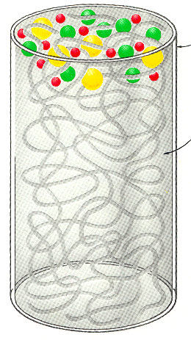
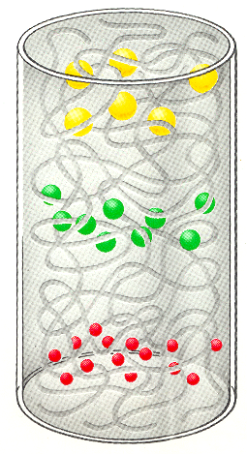
_
Gel Electrophoresis
Mixture of macromolecules
Porous gel
Electrophoresis
Small
Medium
Large
+

Slide 4
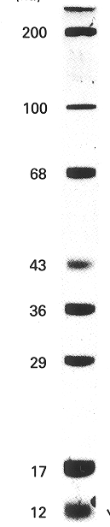
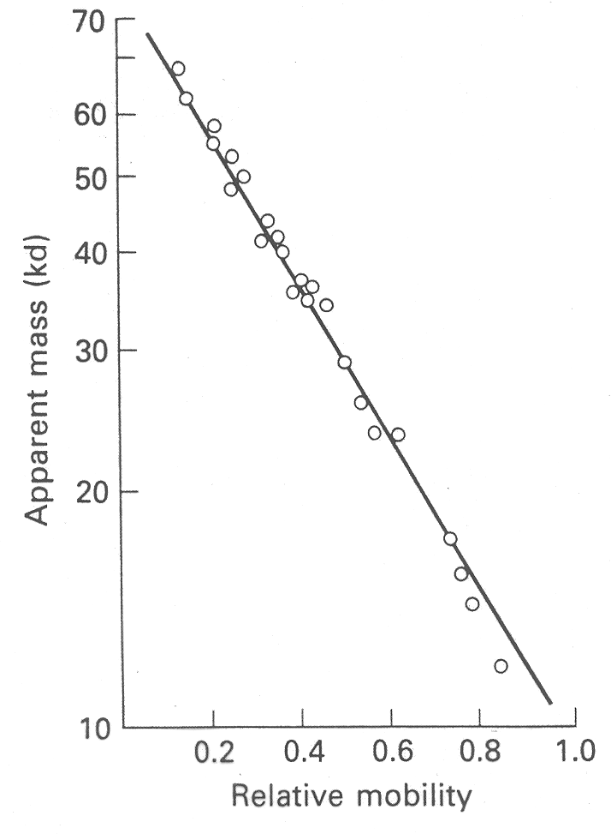
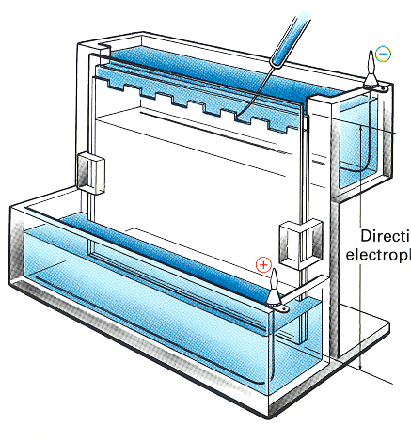
Mass (kDa)
Top
Direction of electro-phoresis
Apparent mass (kDa)
Relative mobility
Bottom

Slide 5
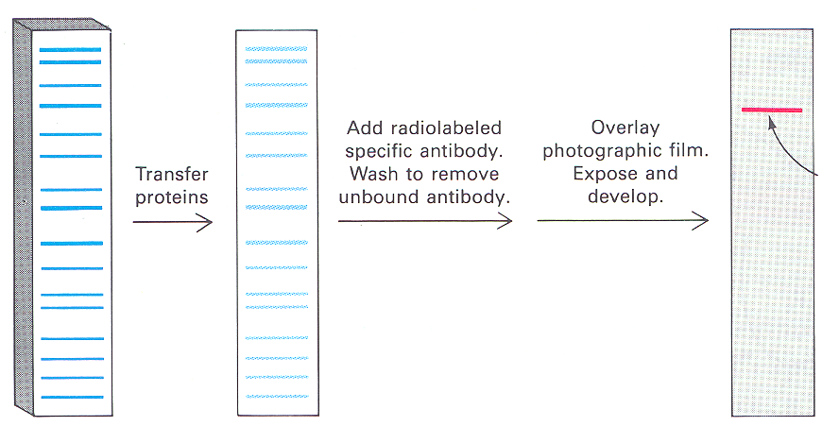
Immuno-blotting (Western blotting)
Protein band detected by specific antibody
Add radiolabeled specific antibody,
wash to remove unbound antibody
Overlay photographic film,
expose and develop
Transfer proteins
SDS-polyacrylamide gel
Auto-radiogram
Polymer sheet

Slide 6
Protein Purification

Slide 7
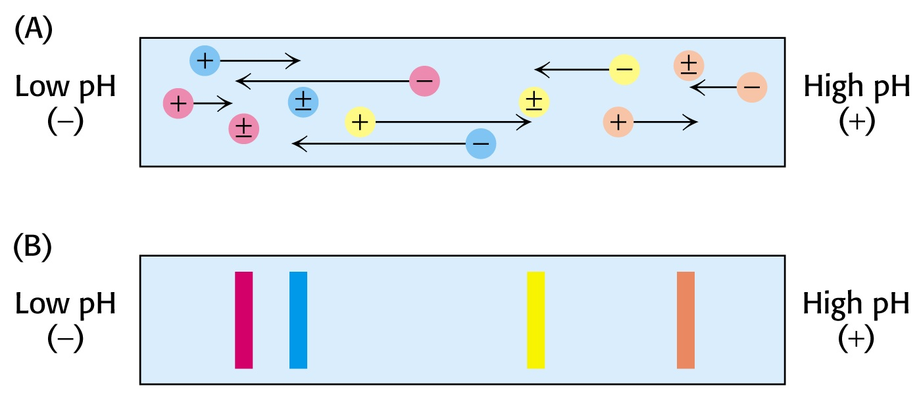
Iso-electric focusing
(+)
(-)
(+)
(-)

Slide 8
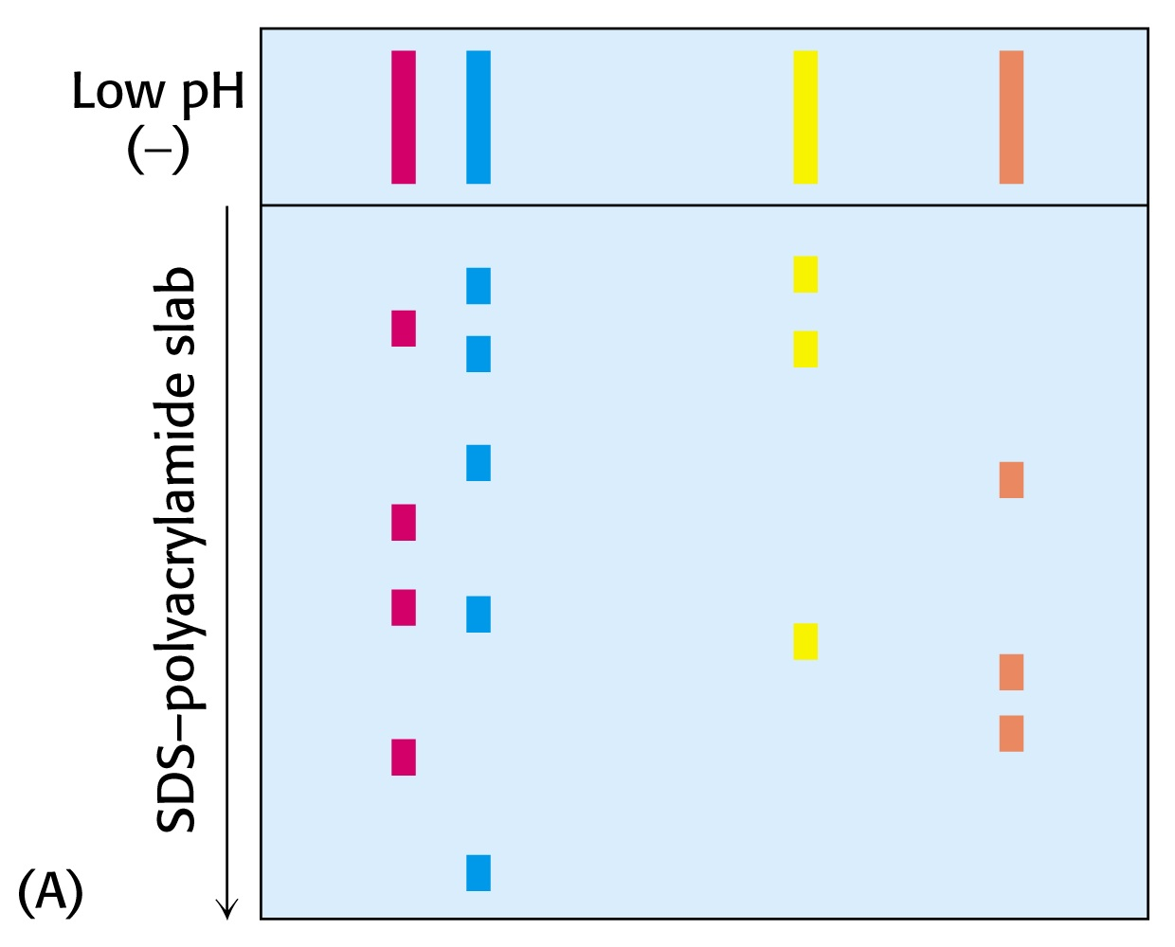
Two-dimensional gel electrophoresis
High pH
(+)
Iso-electric focusing dimension
(+)
(-)

Slide 9
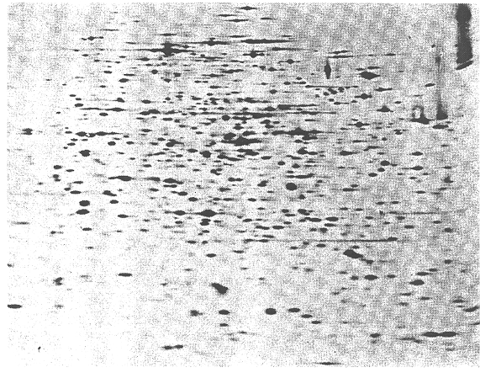
Two-dimensional (2-D) gel electrophoresis
Isoelectric focusing dimension
Proteins migrate in the applied field / pH gradient until they reach their isolectric point and then stop there
SDS-PAGE dimension
Low
pH gradient
High
+ve
Electrical field
-ve

Slide 10
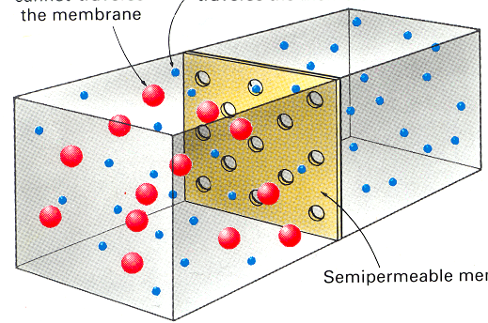
macromolecules
Dialysis across a membrane
small molecules
Large molecules cannot cross the membrane
Small molecules can
Semi-permeable membrane

Slide 11
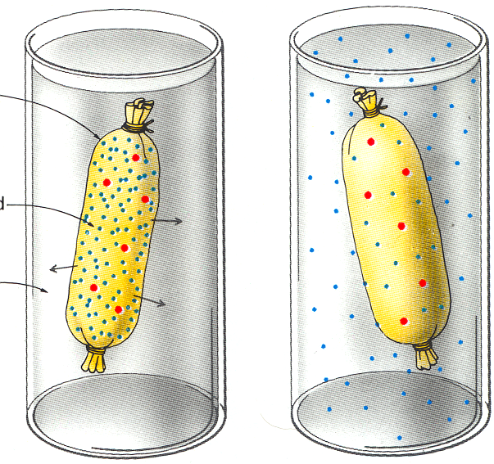
Equilibrium dialysis
macromolecules
small molecules
Dialysis bag
Concentrated solution
Buffer
At start of dialysis
At equilibrium

Slide 12
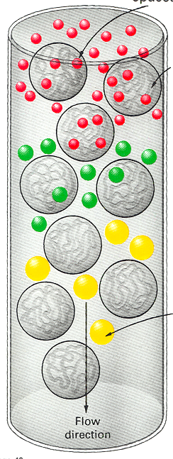
Gel filtration
(size exclusion) chromatography
Small molecules can enter the spaces (pores) within beads
Carbohydrate polymer bead
Flow direction
Large molecules cannot enter
Small
Medium
Large

Slide 13
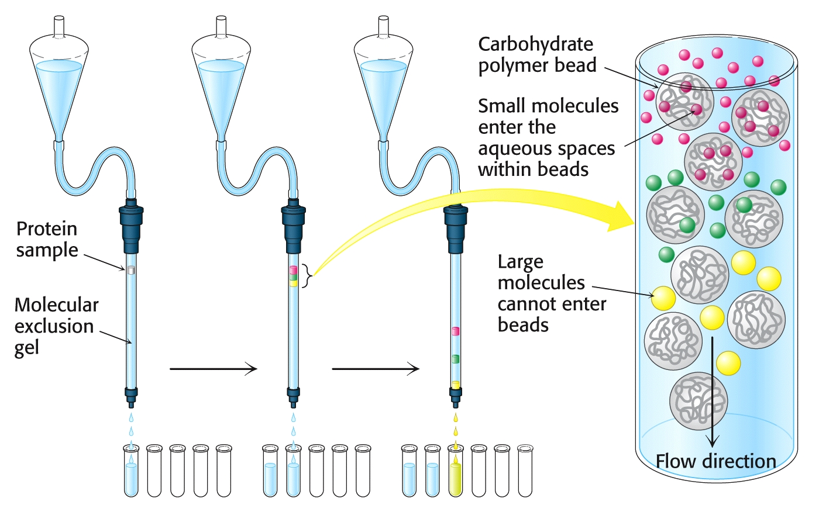
Gel filtration (size exclusion) chromatography

Slide 14
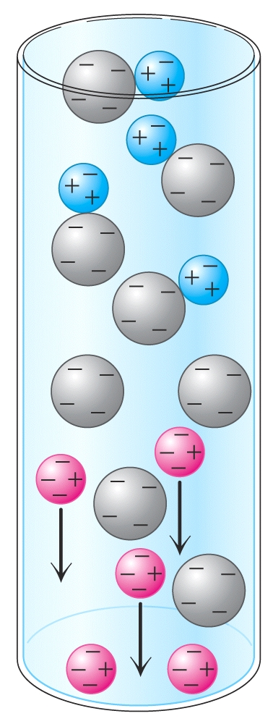
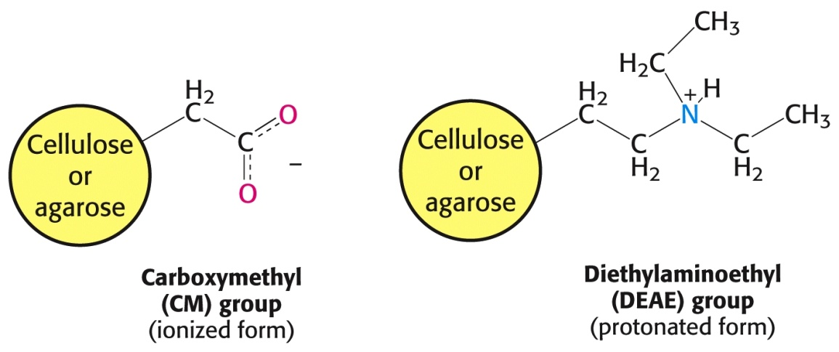
Ion exchange chromatography
Positively charged proteins bind to
negatively charged beads*
Flow direction
Negatively charged proteins flow through
* e.g., carboxymethyl cellulose

Slide 15
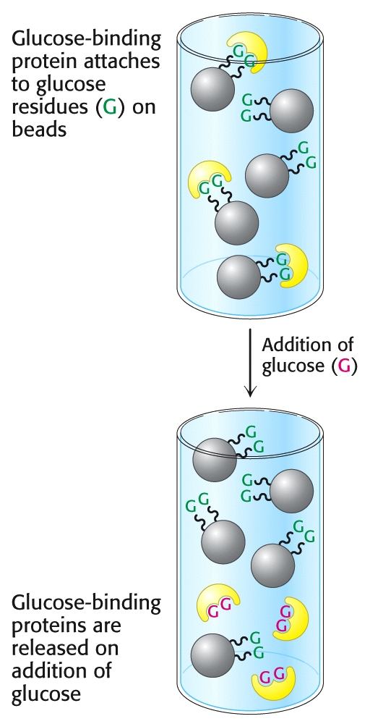
Affinity chromatography
Example 1. Purifying a glucose binding protein

Slide 16
What if you have a recombinant protein?

Slide 17
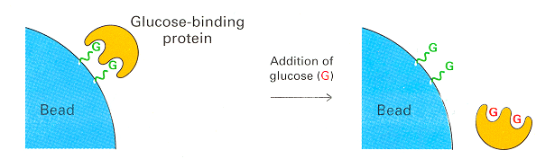
Affinity chromatography
Example 2. Purifying a histidine-tagged protein
Ni-trinitrilo acetic acid (Ni-NTA) bead
I
I
I
Ni
His-tagged protein
Ni
I
Ni
Ni
Ni
Ni
Ni
Ni
I
Ni
Addition of imidazole (I)
Ni
Released protein
Ni
Ni
Bead
Ni
Bead
Ni
I
I
Ni
Ni
M-S-G-A-Q-Q-E……
clone His-tagged version
M-His₆-linker-M-G-A-Q-Q-E……

Slide 18
Protein Characterization

Slide 19
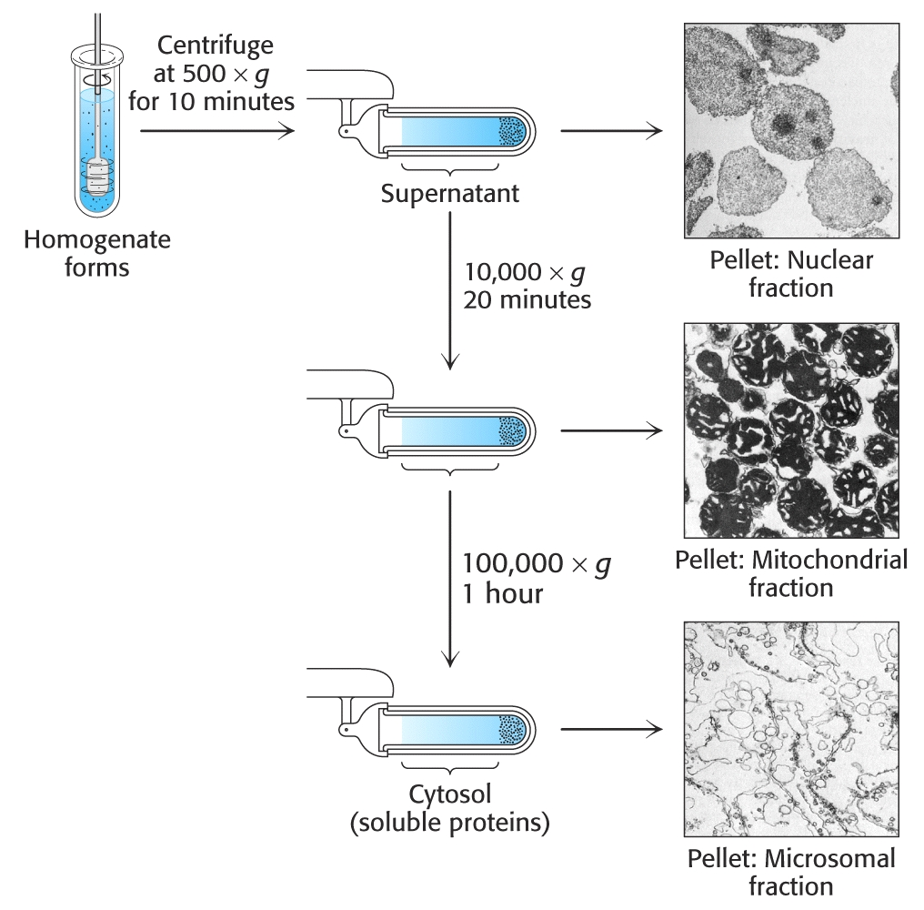
Differential centrifugation

Slide 20
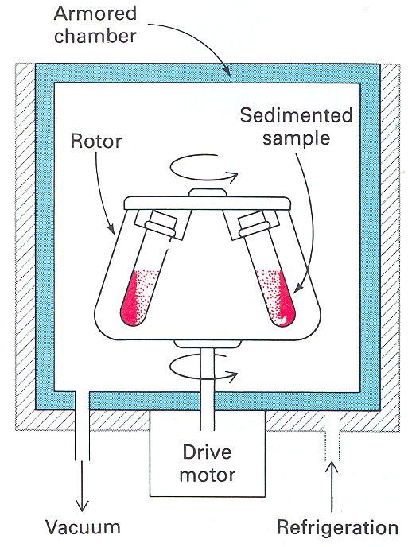
Ultra-centrifugation

Slide 21
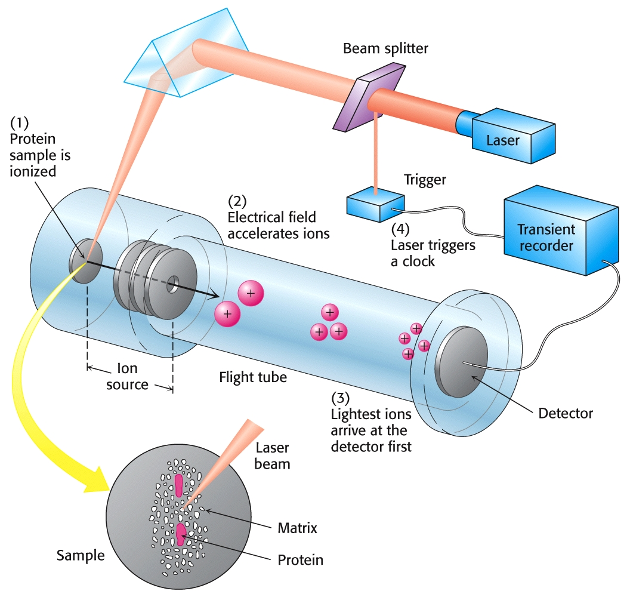
Matrix-assisted laser desorption ionization (MALDI) mass spectrometry

Slide 22
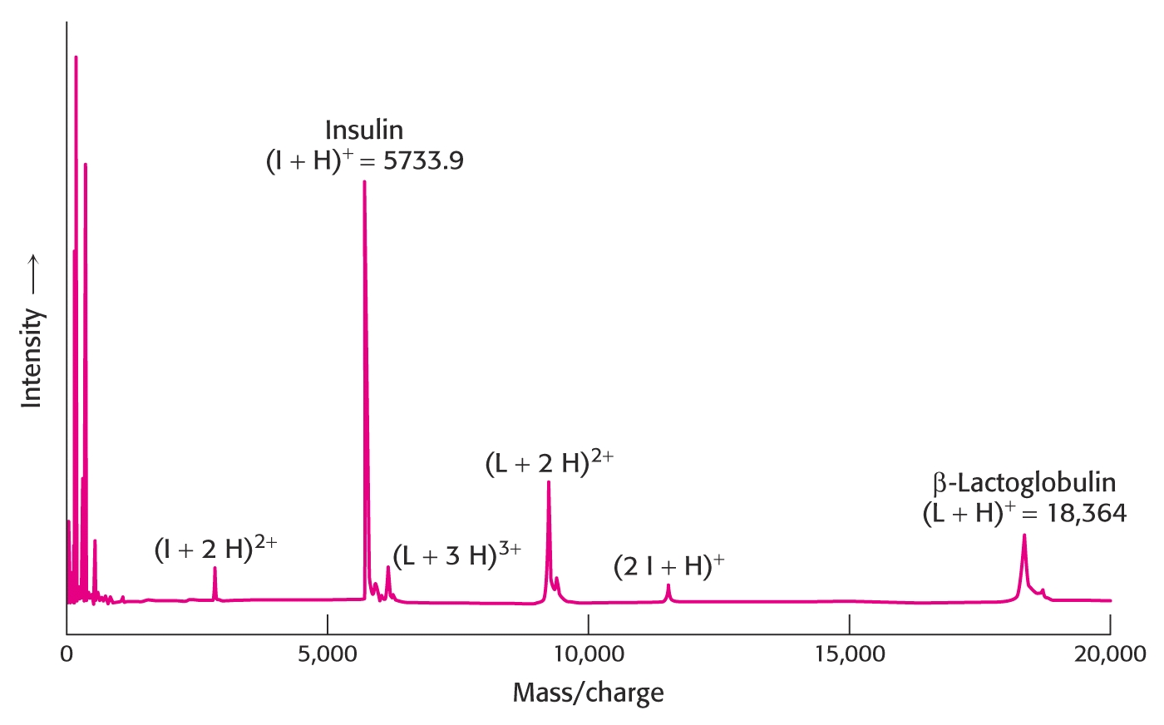
Matrix-assisted laser desorption ionization (MALDI) mass spectrometry
Note the extreme precision of the measurements

Slide 23
More on mass spec
MALDI
ESI
ToF
Sensitivity nowadays at ~12,000
Size/weight of proteins
Also allows identification
Sequencing of proteins
MS/MS
Protein quantification

Slide 24
Protein Structure

Slide 25
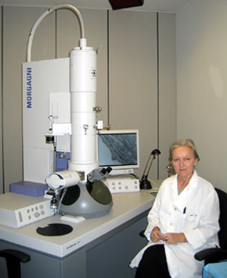
Electron Microscopy
Done in a vacuum
Freeze samples in ethene
Series of 2D images used to elucidate 3D structure
3-20 angstrom resolution

Slide 26
Electron Microscopy
Hepatitis B virus
7.5 Å resolution
Boettcher, Cell 1994

Slide 27
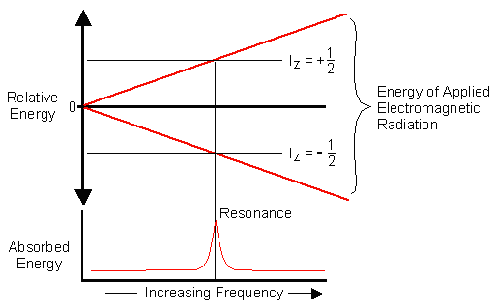
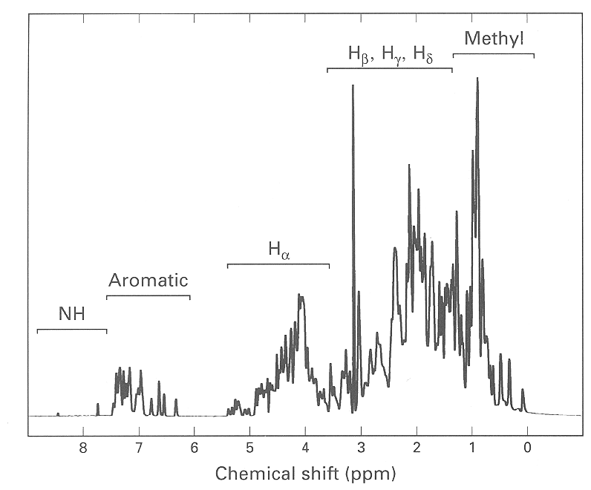
Nuclear Magnetic Resonance (NMR)

Slide 28
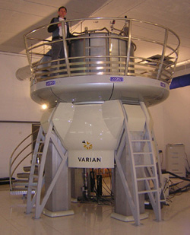
Nuclear Magnetic Resonance (NMR)
No crystallization
No extreme solution conditions
2D NMR can be used to determine structure
“High” resolution
Only for <30 kDa proteins

Slide 29
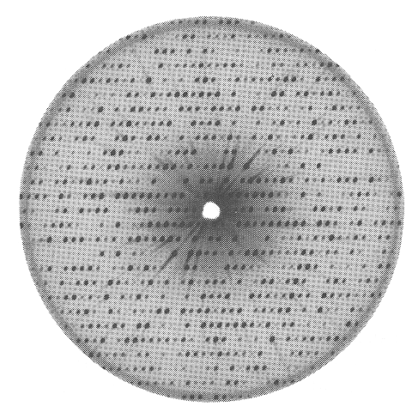
X-ray Crystallography
Hard to crystallize
Conditions vary greatly
More difficult with large proteins
Resolutions down to 1 Å, more frequently 3-10 Å

